Slide 1
STAT 231 Midterm 2 Review
Fall 2024

Slide 2
Look I ran out of ideas for themes ok

Slide 3
Hi I’m Andy (again)
For later questions about this slide deck, you can find me on the UW Stats Club discord server. My handle is @andoiii
This slide deck will be posted on the discord server after today’s session. If this doesn’t happen, please ping me and I will do it promptly.
Remember: You can do it! I believe in you, so you better believe in yourself too. Or else.
3rd Year CS/BBA
STAT 240 (F23)
STAT 231 (S24)
I can do a stats, probably
Acolyptic Laurierite

Slide 4
JOIN THE STATS CLUB

Slide 5
What is the midterm on???
Check your Ruburic lmao
No actually I was looking at it and oh my god its so detailed you can basically make that a cheat sheet its actually crazy
Also the exam is open book??? Lucky you. I’m hoping you prepared your notes.

Slide 6
What is being covered???
QQ Plots and Checking Model Fit
Chapter 3
Chi Squared and T distributions
Estimation (Sections 4.1, 4.2)
Pivotal Quantities
Confidence Intervals
Determining Sample Size
Hypothesis Testing
Likelihood Intervals, CIs and Testing
Multiple Choices of P-values

Slide 7
What is NOT being covered???
Section 4.4: “Use of change of variables to demonstrate a random variable is a pivotal quantity (see example in Tutorial 3)
What the heck does this mean??? I don’t know. I know what a pivotal quantity is. Are they just going to ask you to use Theorems or something?
R code
I’ve tried throwing in some snippets here and there for calculations. But there is no section on the different types of code that might be - I took it in the Spring, see.
Other Content previously covered, or can be open-book-cheesed
Content from Chapters 1 and 2 that were on Midterm 1
PDFs and CDFs of distributions, including Chi-Squared and T, and STAT 230 ones

Slide 8
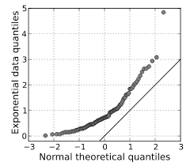
QQ Plots and Model Fit
4 Shapes to Know.

Slide 9
QQ Plots
QQ Plots plot the actual quantiles obtained from Empirical data over the theoretical quantiles of a Gaussian distribution. The data points are $Q_{z}\left(\frac{i}{n+1}\right), q(\frac{i}{n+1})$. Remember, these are just labels for actual numbers!
If the data came from a Gaussian distribution, we would expect the plotted data to follow a reasonably straight line without systematic deviation. Thus, it lets us identify whether the sample is Gaussian or non-Gaussian.

Slide 10
The 4 QQ Plot Shapes you must know
Skewed - Positive
Skewed - Negative
With a right tail, the higher quantiles will be much higher than we would expect. The lower quantiles would “bunch up” on the y-axis.
Thus, we would get a U-shaped curve, concave up.
With a left tail, the lower quartiles will be much lower than expected. The higher quartiles instead “bunch up” on the y-axis.
Thus, we would get a U-shaped curve, concave down.

Slide 11
The 4 QQ Plot Shapes you must know
Kurtosis – Flat and No Tails
Kurtosis – Spiked and Big Tails
With no/little tails, our both the lower quartiles and the upper quartiles with “flatten out” as all the theoretical quantiles share the same actual value.
Thus, we would get a S-shaped curve.
With thick tails, we would see more observations than expected on the right, and less observations than expected on the left, especially with outliers.
Thus, we would get a N-shaped curve.

Slide 12
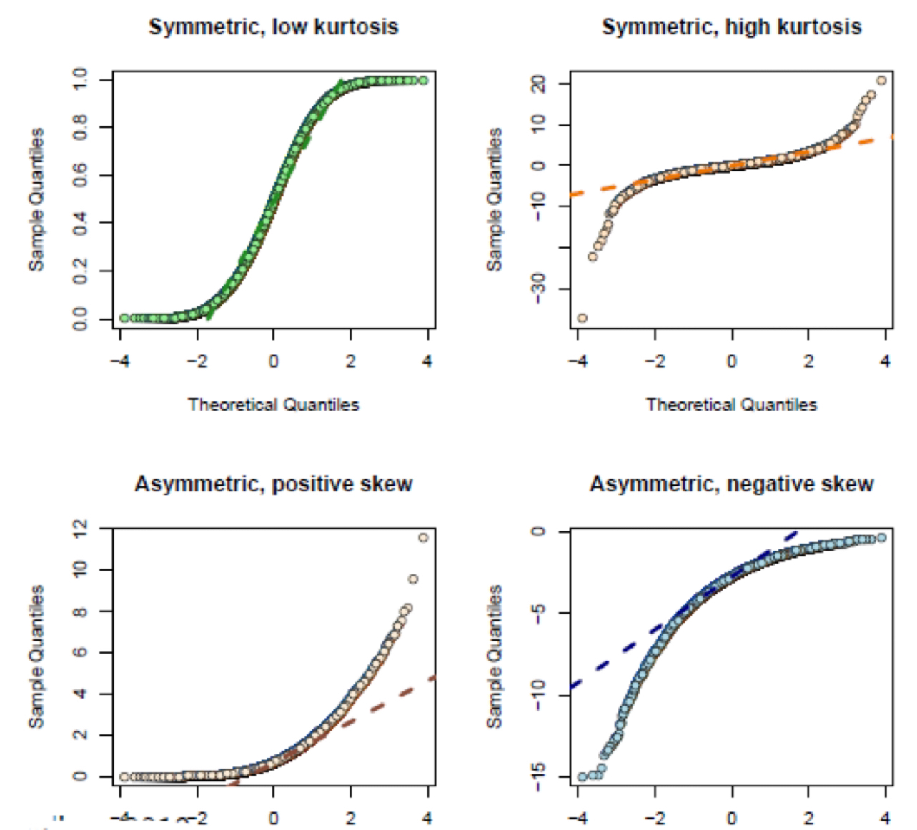
The 4 QQ Plot Shapes - Summary
Source: Lecture Slides from Chelsea Uggenti, STAT 231 Spring 2024

Slide 13
Checking Model Fit
With confidence intervals and hypothesis testing, we may need to check if the data fits a model well. Use previously discussed graphical and numerical summaries to see if it is reasonable to assume fit.
QQ Plots, Histograms, Expected Frequencies, ECDFs
Mean, Median, Mode, Skew, Kurtosis…

Slide 14
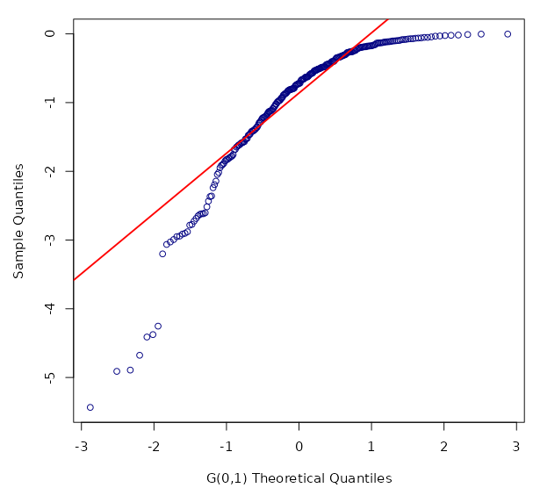
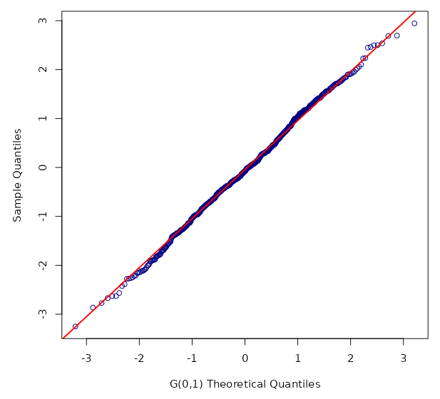
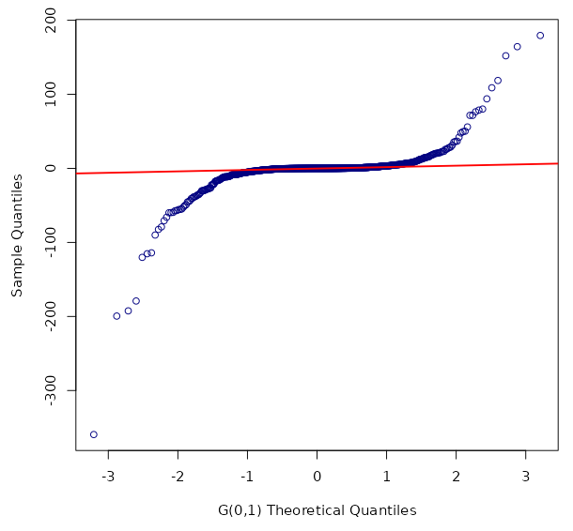
Exercise

Slide 15
Exercise
Left Skew
Normal
Thick Tail

Slide 16
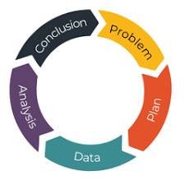
Chapter 3
It’s mostly terms to know

Slide 17
PPDAC
PPDAC is a series of steps used in an empirical study.
Problem – Clearly define the study’s objective.
Plan – Plan study procedure, including data collection
Data – Do the data collection outlined earlier
Analysis – Do some stats on that data mmmm
Conclusion – Draw conclusions about the problem

Slide 18
Terms 1
Target Population/Process – Collection of units we be studying
Units – A specific object that you can collect data about
Variate – Characteristics of your units. Comes in flavours
Attribute – A function of the variates over the target population
Types of Problems
Descriptive – Determine an attribute about the target population
Causative – Is there a causal relationship between 2 variates?
Predictive – What would the response variate do if we do this?

Slide 19
Terms 2
Study Population – The collection of units that we have available to study. Since we don’t have access to the entire target population.
Study Error – differences between study population and target population. Relate it back to the attributes being studied!!!
Sampling Protocol – How sampling is done. Ideally randomly. Alas.
Sampling Error – differences between the sample and study pop’s attributes.
Measurement Error – differences in measured and true values of variates.

Slide 20
Exercise
~ Adapted from Spring 2023 Assignment Question ~
Andoiii’s good friend T0RB3N (yes, it’s spelled that way) is a pharmacist (he actually is) trying to determine the effectiveness of a new drug to cure cold symptoms. He hires 150 university students to sit outside in the cold for 5 hours, then randomly administers a placebo, the new drug, or Tylenol. He also asks participants to rate their wellness on a scale of 1 to 10 both before and after the treatment has been administered.
Both parties are blind to which treatment is given. The treatments are randomly delivered to an equal number of participants (50 to each).

Slide 21
Exercise
Define the following:
Objective of the Study
Target Population
Explanatory Variate
Response Variate
A possible Attribute

Slide 22
Exercise
Define the following:
Objective of the Study
To determine the effectiveness of T0RB3N’s new cold medication
Target Population
All humans on Earth
Explanatory Variate
The treatment administered (Placebo, Tylenol, or new treatment)
Response Variate
The change in the participant’s rating of their physical wellness before and after the treatment has been administered
A possible Attribute
The mean difference in change in participant rating between the 3 different treatments.

Slide 23
Exercise
Determine the following:
T0RB3N’s Study Population
A potential source of Study Error
A potential source of Sample Error
A potential source of Measurement Error

Slide 24
Exercise
Determine the following:
T0RB3N’s Study Population
University Students at the university he is conducting the study at
A potential source of Study Error
University students are not representative of the whole population. The new treatment may have a different level of effectiveness for people of different age groups, maybe.
A potential source of Sample Error
A systematic difference between Sampled University students and the Study Population. For instance, since they are volunteers, they may be less likely to get an adverse reaction from the new treatment, being aware of the risks.
A potential source of Measurement Error
Asking participants to rate their own perception of wellness. Ratings of self are notoriously unreliable which can lead to inaccurate measurements.

Slide 25
Chi Squared and T
New distributions! No way oh my god

Slide 26
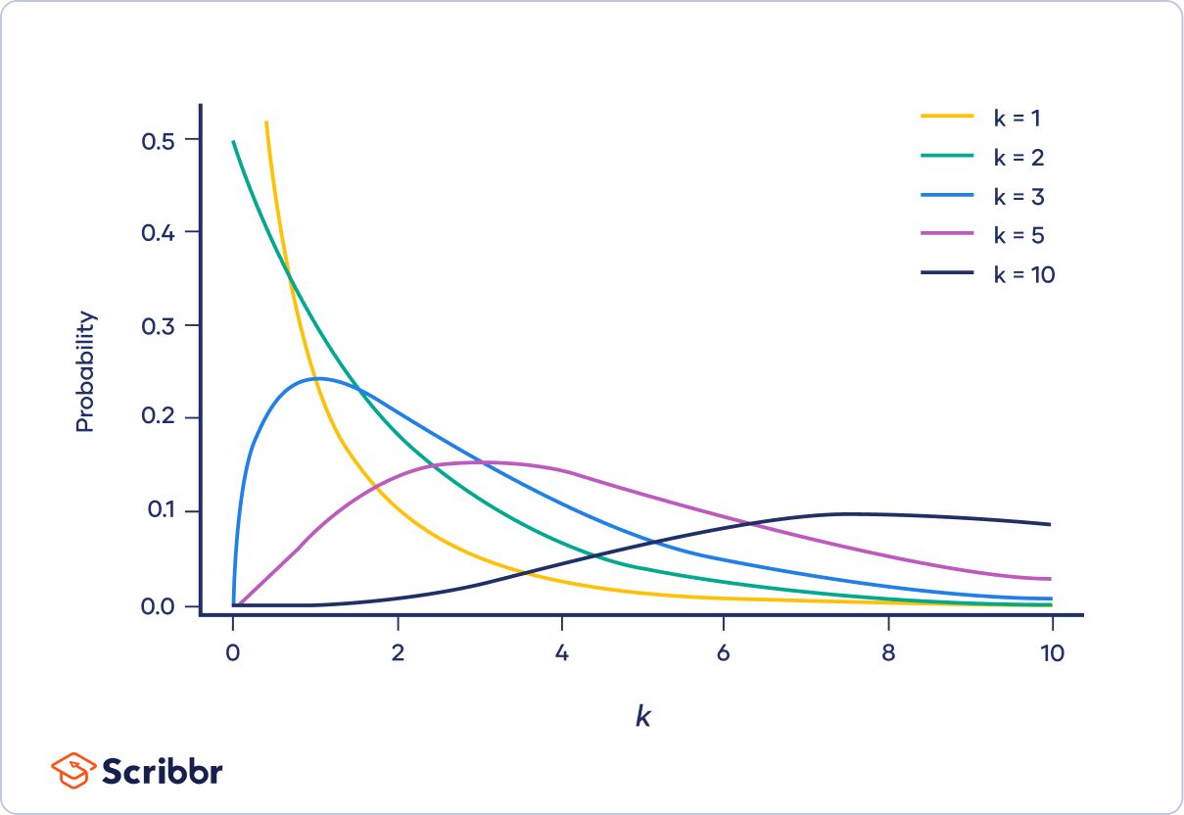
$χ^{2}(k)$ Chi Squared
Absolutely terrifying PDF
Commonly denoted $W∽χ^{2}\left(k\right)$
If $Z∽G\left(0,1\right)$ then $Z^{2}∽χ^{2}\left(1\right)$
If $X∽Exp\left(2\right)$ then $X∽χ^{2}\left(2\right)$
If $Z_{i}∽N(0,1)$ then $\sum{Z_{i}^{2}}∽χ^{2}\left(n\right)$
Sums of $χ^{2}$ is a $χ^{2}$ whose df is the sum of the dfs being summed.
As $k$ grows it behaves like $G(k,\sqrt{2k})$
https://rshiny.math.uwaterloo.ca/sas/stat231/tandchisquare/

Slide 27
$χ^{2}(1)$ Probabilities
Let $W∽χ^{2}(1)$. Then,
$$P\left(W≤w\right)=P\left(Z^{2}≤w\right)=P\left(−\sqrt{w}≤Z≤\sqrt{w}\right)=2P\left(Z≤\sqrt{w}\right)−1$$
$P\left(W≥w\right)=P\left(Z^{2}≥w\right)=2P\left(Z>\sqrt{w}\right)=2[1−$ $P\left(Z≤\sqrt{w}\right)]$

Slide 28
$χ^{2}(2)$ Probabilities
Let $W∽χ^{2}(2)$. Then,
$$P\left(W≤w\right)=P\left(X≤w\right)=1−e^{−w/2}$$
$$P\left(W≥w\right)=P\left(X≥w\right)=e^{−w/2}$$

Slide 29
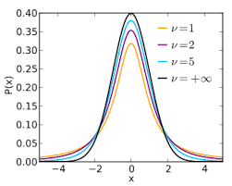
$T(k)$ Student-T
Even more absolutely terrifying PDF
Commonly denoted $T∽t\left(k\right)$
If $Z∽G\left(0,1\right)$ and $U∽χ^{2}\left(k\right)$ independently, then
$$T=\frac{Z}{\sqrt{U/k}}∽t\left(k\right)$$
The t-distribution is symmetric around 0, has thicker tails, and approaches $G\left(0,1\right)$ for large $k$
Basically lets us use sample variance
https://rshiny.math.uwaterloo.ca/sas/stat231/tandchisquare/

Slide 30
Determining Probabilities/Quantiles
One way is to use a table. Remember to use the right degrees of freedom! Additionally, if an entry is not listed, the best you can do is provide a RANGE of the probability.
You can also use R:
pchisq(q, df)
qchisq(p, df)
pt(q, df)
qt(p, df)

Slide 31
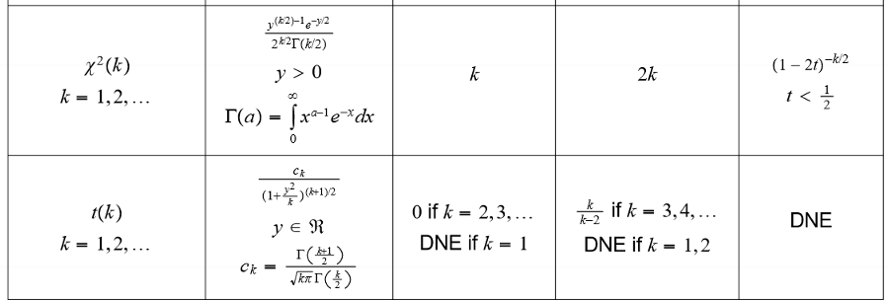
Also, Mean and Variance

Slide 32
Estimation
Roadmapping for Confidence Intervals and stuff.

Slide 33
The 2 Model System
With estimation, there are 2 models:
A model for the variation in the population being studied, along with their attributes
A model taking into account how data is collected, built with the previous model.
Remember, when we get an estimate out for a parameter, it’ll only ever be an estimate. We wish to quantify how “good” our estimates will be.
Other Issues in modelling that we assume are solved from Chapter 1 - 3
Where does this model come from? Is this model accurate / a good fit?
How do we get random samples and ensure variates are measured without error?

Slide 34
Estimators and their Distributions
A point estimate of $θ$ is denoted $\hat{θ}=g(y)$, being a function of the observed data. As the data are random variables, so is the point estimator $\tilde{θ}=g\left(Y\right)$
There is $θ,\hat{θ},\tilde{θ}$, respectively the true population parameter, point estimate, and estimator. The estimator is a rule to generate point estimates.
As $\tilde{θ}$ is a random variable, it has a distribution. We call it the sampling distribution of the estimator.
The sampling distribution can be determined by graph, by math, or by using the Central Limit Theorem. (Ex. $\overline{Y}$ from $Y$)
Remember: The sum of Gaussians are Gaussian. Thus, the sample mean is Gaussian.
Remember: The sample mean of Non-Gaussians approaches a Gaussian for large n.

Slide 35
Pivotal Quantities
What are they? The key to remembering a lot less.

Slide 36
A what now?
A pivotal quantity $Q=g(Y, θ)$ is a function of ONLY the data and unknown parameter(s) so that the distribution of $Q$ is fully known.
This is useful as it allows us to find a distribution that relates to our sample!
Used both in Confidence Intervals and Hypothesis Testing.
Approximate Pivotal Quantities are pivotal quantities that only really have a known distribution for a sufficiently large sample size $n$, in part due to the Central Limit Theorem
Look just use it as a Pivotal Quantity anyways it’s a semantic difference

Slide 37
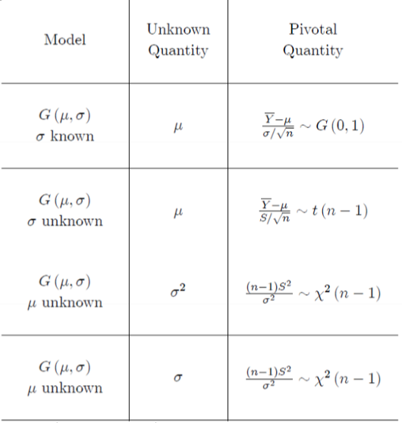
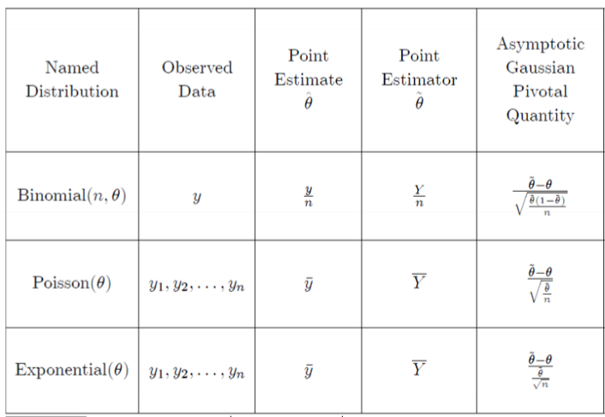
Examples

Slide 38
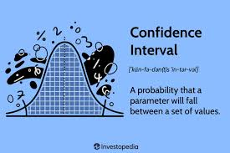
Confidence Intervals
Ranges of Confidence

Slide 39
The Interval Estimate
At the abstract level, we want an interval estimate $[L\left(Y\right), U\left(Y\right)]$ for $θ$.
The goodness of the interval estimate depends on its coverage probability, or:
$$p=P(θ∈\left[L\left(Y\right), U\left(Y\right)\right])$$
Note: $θ$ is static! We are trying to capture the true but unknown value of $θ$ in the interval. This coverage probability across multiple interval estimates.
We want a set of rules to determine $\left[L\left(Y\right), U\left(Y\right)\right]$ that gives large (but not 100%) coverage probabilities while also being as narrow as possible.
A $100p\%$ confidence interval is one with coverage probability $p$. $p$ is also known as the confidence coefficient.

Slide 40
Constructing Confidence Intervals
Use the correct (approximate) pivotal quantity for the job.
To later extract a $100p\%$CI, start with $p=P(a≤g(Y;θ)≤b)$. As $g\left(Y;θ\right)=Q$ has known distribution, determine quantiles $a,b$.
Probably $\frac{1−p}{2}=P(Q≤a)$ and $\frac{1−p}{2}=P\left(Q≥b\right)$ or something similar. This leaves you with $P\left(a≤Q≤b\right)=p$ as needed.
For normal and T-distributions, it’s going to be symmetric to minimize the interval length. Thus, $a=−b$.
Isolate $θ$ from $g(Y;θ)$, moving them across the inequalities as needed.
Would you look at that! You now have a Confidence Interval.

Slide 41
Interpretation and Facts
As confidence level increases, the interval becomes wider
As sample size increases, the interval becomes narrower
The confidence interval can end up looking like
$$Point Estimate ±c ×Std Dev. of Estimator$$
The 2nd part is known as the margin of error.
There are only 2 ways to interpret a confidence interval correctly:
We are $100p\%$ confident that the true population value of $θ$ lies in the interval.
When sampling repeatedly from the same population and constructing CIs from the same process, we would expect $100p\%$ of the intervals constructed to contain the true population value of $θ$
The interval DOES NOT have a $100p\%$ chance of containing $θ.$

Slide 42
Exercise
Being the nerd that he is, Andoiii (Andy’s draconic alter-ego) is running a study to determine the drop rate of the elusive Shadow of Tumenken, obtained as a raid drop from the hit MMORPG Old School Runescape.
Assume the process of getting a drop or not follows a Binomial distribution. After grinding out 2000 raids (this translates to around 56 days) he gets $\hat{θ}=0.001$. Is the Normal Approximation appropriate for constructing a CI? Regardless, determine a $95\%$ confidence interval for $θ$, the true drop rate of the Shadow of Tumenken from the hit game Old School Runescape. Does 1.5% seem reasonable?
wizard lizard

Slide 43
Exercise
I don’t remember where I saw this, but this appeared on my midterm. For the Normal Approximation to be valid for this Binomial data, we need $n\hat{θ}≥5$ and $n(1−\hat{θ})≥5$. This is not the case since $n\hat{θ}=2$. So, no.
Ignoring that, our pivotal quantity is $\frac{\tilde{θ}−θ}{\sqrt{\frac{\tilde{θ}(1−\tilde{θ})}{n}}} \sim G(0,1)$. Therefore, We have $p=0.95=P(a≤Z≤b)$.
Then, $0.95=$ $P(−c≤Z≤c)$ means $c=z_{\frac{1+0.95}{2}}=z_{0.975}=1.96$. So, $0.95=P\left(\tilde{θ}−1.96\sqrt{\frac{\tilde{θ}\left(1−\tilde{θ}\right)}{n}}≤θ≤\tilde{θ}+1.96\sqrt{\frac{\tilde{θ}\left(1−\tilde{θ}\right)}{n}}\right)$, after rearranging
Plug in $\hat{θ}$ and we get a confidence interval of (-0.00038, 0.00239)
We are 95% confident the true drop rate lies in the above interval. Since 0.015 is in the CI, it seems like a plausible value for the drop rate.

Slide 44
Asymmetric Confidence Intervals
When you do confidence intervals for $σ^{2}$ or $σ$, you use the Chi-squared distribution as your pivotal quantity. Alas, it is asymmetric.
So, don’t do $a=−b$. But, $P\left(W≤a\right)=P\left(W≥b\right)=\frac{1−p}{2}$ still holds.
Also, they share the same pivotal quantity – just remember to take the square root for standard deviation, and not to do so for variance.

Slide 45
Confidence Interval Reference
It’s in the notes. They even give you shortcuts on how to calculate the quantiles! Nice.
It may be worth remembering these CI formulas, if you want. However, you can always just rederive them from the pivotal quantities.
Attached are screenshots of parts of the tables for the Confidence Intervals that showed up on my midterm reference sheet back in the day.

Slide 46
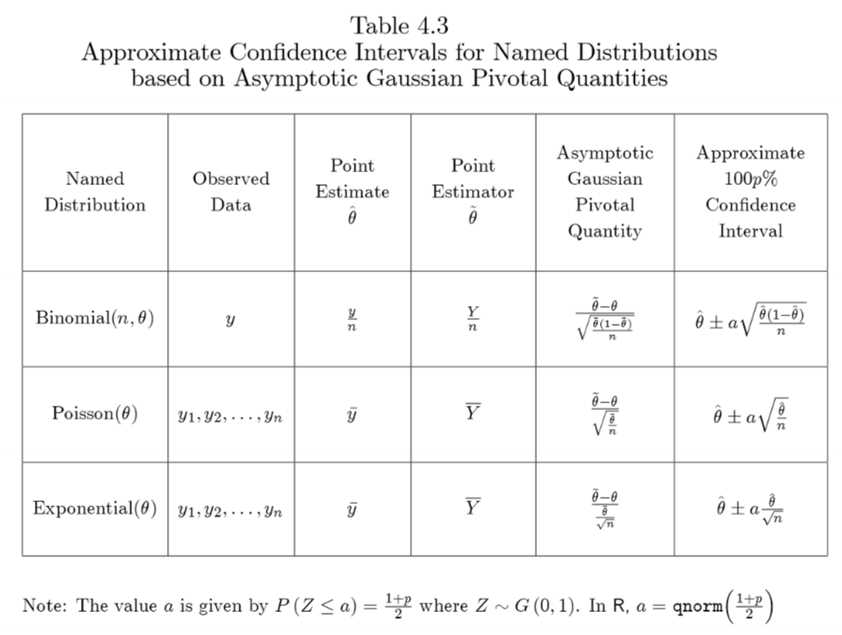
Confidence Interval Reference

Slide 47
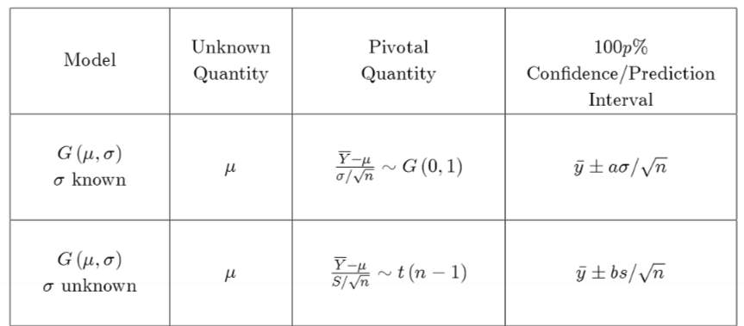
Confidence Interval Reference

Slide 48
Margin of Error
Determining just the right amount of effort to put in

Slide 49
The Margin of Error Calculation
Case 1: Binomial Distribution that is Approximately Gaussian
Say we have a 95% approximate CI for a binomial proportion. The formula for that is $\hat{θ}±1.96×\sqrt{\frac{\hat{θ}(1−\hat{θ})}{n}}$
Thus, the width of the CI is $2×1.96×\sqrt{\frac{\hat{θ}(1−\hat{θ})}{n}}$. We can then, say, choose to enforce $2×1.96×\sqrt{\frac{\hat{θ}(1−\hat{θ})}{n}}≤2(0.03)$ and solve for $n$ to limit our width/MOE.
However, we need $\hat{θ}$. To be safe, because of calculus, assume $\hat{θ}=0.5$ and do the calculation. If you get a decimal value of $n$, round up.

Slide 50
Excercise
Recall Andoiii’s attempts to find the drop rate of the Shadow of Tumenken. He wants his 95% confidence interval to have a margin of error of 0.1%. In other words, the CI should have a width of at most 2(0.001). How many runs does he need to do?

Slide 51
Excercise
Recall Andoiii’s attempts to find the drop rate of the Shadow of Tumenken. He wants his 95% confidence interval to have a margin of error of 0.1%. In other words, the CI should have a width of at most 2(0.001). How many runs does he need to do?
It’s as simple as using the formula: $2×1.96×\sqrt{\frac{0.5 (0.5)}{n}}≤2(0.001)$
$$\frac{0.5}{\sqrt{n}}≤\frac{0.001}{1.96}→\sqrt{n}≥980→n≥960400$$
Wow. Ok. So 960k runs, each 40 minutes long. Maybe he should just ask the developers instead. Of course, this IS a conservative estimate…

Slide 52
The Margin of Error Calculation
Case 2: Gaussian Distribution with KNOWN standard deviation
For a 95% approximate CI, the formula for is $\overline{y}±1.96×\frac{σ}{\sqrt{n}}$
Similar to before, to get a width of $2M$ (margin of error of $M$) we can rearrange this to get $n≥{\left(\frac{1.96σ}{M}\right)}^{2}.$ Remember to round up!
Case 3: Gaussian Distribution with UNKNOWN standard deviation
We can’t use a t-value, since the t-value we’d need requires a sample size…
Instead: we just get a rough value of $σ$, perhaps from an earlier experiment. Then, use the formula above as an approx. Then, bump it a bit higher since we don’t know $σ$ and because t-quantiles are usually bigger.

Slide 53
Hypothesis Testing
A way to see if your data is significant.

Slide 54
From the Barebone Basics
The essence of the matter is that there are 2 hypothesis – null hypothesis $H_{0}$ and alternative hypothesis $H_{A}$. We assume the truth of the null and try to gather data to show it is implausible, favouring the alternative.
How do we measure plausibility? We use a test statistic/discrepancy measure $D=g(Y)$, a function that measures agreement between $H_{0}$ and data $Y$.
Being a function of the data, the test statistic is a random variable! The observed value is represented as $d$. This also means it has a distribution (and pivotal quantity…)
We define the statistic so that $d=0$ represents maximal agreement. Larger values indicates stronger evidence against the null hypothesis.

Slide 55
The p-value
The p-value is the probability of seeing data “as unusual or more” than the actual data, given the null hypothesis. Mathematically,
$$p−value=P(D≥d;H_{0})$$
P-values are not the probability of the data. It’s more a measure of “surprise” from the data we see.
Smaller p-values convey the data seen is more unlikely or surprising. Most science uses statistical significance. We don’t do that here.

Slide 56
More Things about Hypothesis Testing
It is possible for us to make a false conclusion.
Type I error (false positive): $α=P(reject H_{0}|H_{0} true)$
Type II error (false negative): $β=P(fail to reject H_{0}|H_{A} true)$
If there is no evidence against $H_{0}$, don’t conclude it is true! We have only assumed that it is true, and that it is reasonable. Stick to the wording in the table for this course.
P-hacking: fucking with the p-value because you’re desperate for grants.
Repeating experiments so much that you eventually by chance get a significant result.
Selectively, “purging” some results or other forms of data fraud.
Practical Significance: A small p-value doesn’t tell us HOW wrong $H_{0}$ is. Maybe it’s small enough that we don’t really need to care.
Back it up with a confidence interval to get magnitude and direction of departure.

Slide 57
Conducting a Hypothesis Test
State both the null and alternative hypothesis.
Determine a test statistic to use. Calculate the observed value.
You probably want to use a pivotal quantity for easier p-value calculations. However, generally anything that fits the criteria of a test statistic works.
Dependent on if the test is one-sided or not, throw absolute values on.
You may also need to replace some $\tilde{θ}$ with $θ_{0}$ since pivotal quantity is based off $θ_{0}$
Compute the p-value. Exact calculation depends on one-sidedness and if the distribution is symmetric or not (tests for variance)
Draw a conclusion using one of the sample phrases earlier.
In R for t-tests, use t.test(y, mu=$μ_{0}$)
where y <- c(data1, ..., dataN)

Slide 58
Exercise
Any Minecrafters in here? Now-disgraced speed-runner Dream, enacted 266 barters with Piglins, with 41 of them (15.4%) resulting in Ender Pearls. Data trawled from the code suggests that the rate is 20 in 423, or about 4.73%.
Is Dream too lucky or unlucky? Or is the drop rate wrong? Assume the result from the Piglin bartering process (specifically if it is an Ender Pearl trade or not) is a Binomial process.

Slide 59
Exercise
First, we define the null and alternative hypotheses:
$$H_{0}: θ={20}/{423} H_{A}: θ≠{20}/{423}$$
As we have Binomial Data, we use $\frac{\tilde{θ}−θ}{\sqrt{\frac{\tilde{θ}(1−\tilde{θ})}{n}}} \sim G\left(0,1\right)$ as our pivotal quantity. Considering this is a 2-sided test, and we are basing it off the assumed true proportion of 20/423, our test statistic is:
$$D=\frac{\left|\tilde{θ}−{20}/{423}\right|}{\sqrt{\frac{{20}/{423}({403}/{423})}{n}}}→d=8.211$$

Slide 60
Exercise
Now, the p-value:
$$p−value=P\left(D≥8.211; H_{0}\right)=P\left(\left|Z\right|≥8.211\right), Z \sim G(0,1)$$
$$=2×\left[1−P\left(Z≤8.211\right)\right]$$
$$=0$$
It’s so small even R refuses to round it away from 0…
There is very strong evidence against the null hypothesis that Dream’s population proportion is 20/423. In the context of the study, there is very strong evidence that Dream’s drop rate is different, or that he cheated.
He did cheat, by the way.

Slide 61
One-Sided Tests
You aren’t being tested on this??? oops
Maybe the null hypothesis isn’t just an equal sign.
Doesn’t matter. Whether it is 1-sided or not is solely determined by the alternative hypothesis.
Change test statistic and p-value calculation accordingly.
Source: Lecture Slides from Chelsea Uggenti, STAT 231 Spring 2024

Slide 62
The wacky rule for Variance Tests
This only applies to tests for variance/standard deviation that are TWO SIDED. One sided tests are fine.
Due to the asymmetry in the Chi-Squared distribution, and that we only have 1 test statistic value, we run into a bit of a problem… there is no “other end”!
We approximate the p-value to be either $2P(U≤u)$ or $2P(U≥u)$ where $u$ is the observed value of the test statistic/pivotal quantity.
We essentially use either twice the left tail probability, or twice the right tail probability. We choose the one that gives us a p-value less than 1.

Slide 63
Connections: Testing and CIs
When testing for $H_{0}:θ=θ_{0}$, a $100p\%$ confidence interval corresponds to a p-value of $p$. For example:
If $θ_{0}$ is contained in a 95% confidence interval, then the p-value is greater than 0.05.
If $θ_{0}$ is NOT contained in the 95% CI, then the p-value is smaller than 0.05.
In general, the parameter value $θ=θ_{0}$ is in a $100p\%$ CI for $θ$ if and only if the p-value from testing $H_{0}:θ=θ_{0}$ is greater than $1−p$.
This result only approximately holds if different pivotal quantities are used for the CI and the p-value. But otherwise, it’s a quick way to get a p-value, if you happen to have a confidence interval handy.

Slide 64
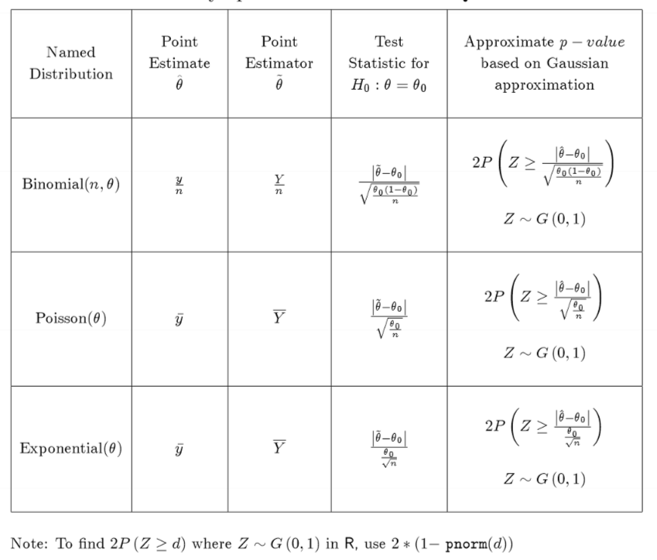
Hypothesis Testing Reference

Slide 65
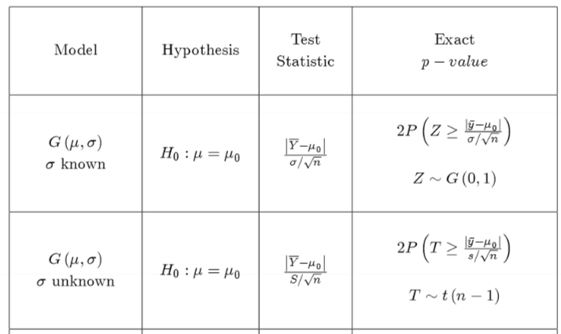
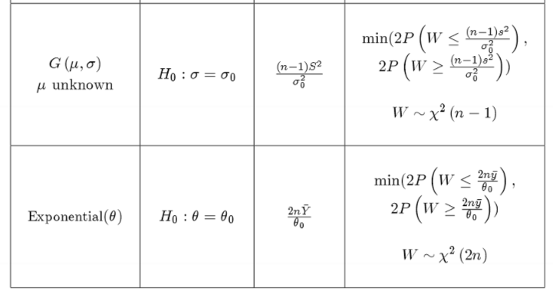
Hypothesis Testing Reference

Slide 66
Likelihood Ratios
Likelihood Intervals, Likelihood Based Cis, Likelihood Based Hypothesis Testing. There is so much to yap about.

Slide 67
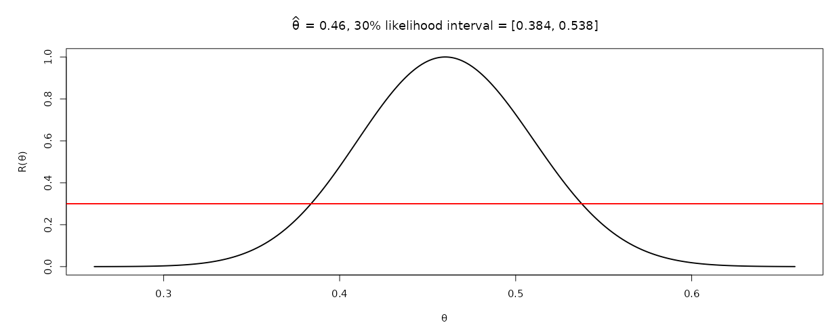
The Likelihood Interval
Recall the relative likelihood function $R\left(θ\right)=\frac{L(θ)}{L(\hat{θ})}$. Instead of doing CIs, we can borrow this function to quickly get an interval estimate!
In general, a $100p\%$ likelihood interval is the set $\left\{θ|R(θ)≥p\right\}$
How do get one?
Graph and eyeball with a ruler
In R, uniroot

Slide 68
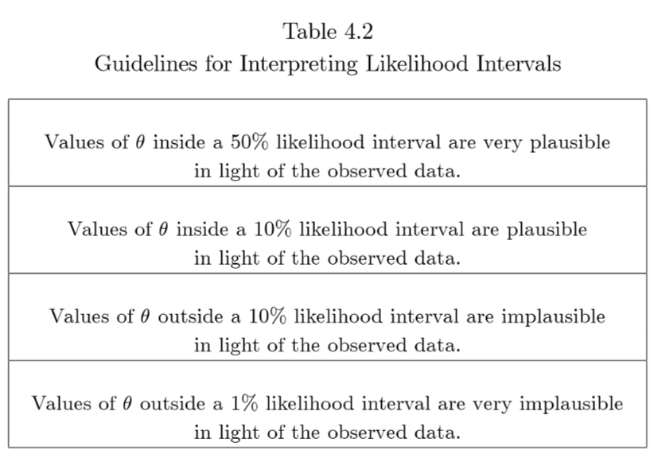
Interpreting and Trivia
A Likelihood Interval with a smaller $p$ means a LARGER interval.
A larger $n$ for $R(θ)$ overall shrinks the size of the LI.
The LI can be disjoint if the distribution isn’t unimodal. Fortunately, we only deal with unimodal distributions.
Remember to review likelihood functions!!!

Slide 69
Using $r(θ)$ instead of $R(θ)$
Sure, why not? The main difference between the two is in shape - $R\left(θ\right)$ usually has a Normal PDF shape while $r\left(θ\right)$ is a quadratic shape.
To obtain a Likelihood Interval from $r\left(θ\right)=\log{R\left(θ\right)}$:
$$100p\% LI=\left\{θ|R(θ)≥p\right\}=\left\{θ|\log{R(θ)}≥\log{p}\right\}$$
$$=\left\{θ|r(θ)≥\log{p}\right\}$$
I think that’s about it.

Slide 70
The Likelihood Statistic
The likelihood ratio statistic is
$$Λ=Λ\left(θ;\tilde{θ}\right)=−2r\left(θ\right)=−2\log{\frac{L(θ)}{L(\tilde{θ})}=2[l\left(\tilde{θ}\right)−l\left(θ\right)]}$$
If $L(θ)$ is based off data $Y$, a random sample of size $n$, and $θ$ is the true population parameter we are trying to estimate, then
$$Λ \sim χ^{2}\left(1\right) as n→∞$$
Basically, we can use it as an approximate pivotal quantity!

Slide 71
Likelihood-Based Confidence Intervals
Consider a $100p\%$ likelihood interval. Let’s write this as a CI:
Note $R\left(θ\right)≥p↔−2r\left(θ\right)≤−2\log{p}$. Thus, this is approx. $Λ≤−2\log{p}$
Forcing this to be a CI. Set the interval to be the same. What confidence coefficient $q$ would have generated it? Well, we would have that:
$$q=P(Λ≤−2\log{p})$$
Simplify:
$$=P\left(W≤−2\log{p}\right)=P\left(Z^{2}≤−2\log{p}\right)=P(\left|Z\right|≤\sqrt{−2\log{p}})$$
$$q=2P\left(Z≤\sqrt{−2\log{p}}\right)−1$$
Thus, the $100p\%$ likelihood interval is a $100q\%$ confidence interval.

Slide 72
Likelihood-Based Confidence Intervals
Consider a $100p\%$ confidence interval. Let’s write this as a LI:
By the confidence coefficient, lets force it to be a probability statement in terms of $Λ$: $p=P(W≤c)$ for some value of $c$, $W \sim χ^{2}(1)$
Now, $P\left(W≤c\right)=P\left(Λ≤c\right)=P\left(−2\log{R\left(θ\right)}≤c\right)=P(R\left(θ\right)≥e^{{−c}/2})$
The innards of the probability definition define the range of the CI, thus the confidence interval is equivalent to the set $\left\{θ|R\left(θ\right)≥e^{{−c}/2}\right\}$
Thus, a $100p\%$ confidence interval is equivalent to a $100\left(e^{{−c}/2}\right)\%$ likelihood interval!
A 15% Likelihood Interval is an approximate 95% Confidence Interval
A 10% Likelihood Interval is an approximate 97% Confidence Interval

Slide 73
Likelihood-Based Hypothesis Tests
State both the null and alternative hypothesis. Proporse a model for your data to use and derive $L(θ)$ and $\hat{θ}$
Use approximate test statistic $Λ\left(θ_{0}\right)=−2r(θ_{0})$. Also grab observed test statistic $λ\left(θ_{0}\right)$
Compute the p-value. Use the fact $Λ\left(θ_{0}\right) \sim W=χ^{2}(1)$ approximately.
Draw a conclusion using one of the sample phrases earlier.
Yeah it’s just like the other tests. Be sure to use the correct $θ$ when doing calculations!

Slide 74
Multiple Types of P-values
We have like 3 different ways of getting a P-value by now.

Slide 75
Exercise
It’s election time, so I guess we need an election themed question. We have randomly selected 100 American voters and asked if they will vote for the Orange Guy. Our sample proportion is $\hat{θ}=0.48$. We are curious if the true population proportion of Trump supporters is $θ=0.51$ because we want to know if it is joever frfr. (This is a 2-sided test by the way)
Determine a p-value using a test statistic based off the raw Binomial distribution
Determine a p-value using a test statistic based off the Normal Approximation for the Binomial distribution.
Determine a p-value using a test statistic based off the Likelihood Test Statistic.

Slide 76
Exercise
For the Binomial Distribution, consider test statistic $D=\left|Y−nθ_{0}\right|$ where $Y \sim Binomial(100,θ)$. This would simply be just the difference between the observed and expected given the mean. Thus, $d=\left|48−100(0.51)\right|=3$
Now, the p-value:
$$p−value=P\left(D≥3;H_{0}\right)=P\left(Y≤48\right)+P\left(Y≥54\right), Y \sim Bin(100,0.51)$$
Using R code ruthlessly commandeered,
sum(dbinom(0:48, 100, 0.51)) + sum(dbinom(54:100, 100, 0.51))
=0.6172291

Slide 77
Exercise
With the normal approximation, observed value $d=\frac{\left|0.48−0.51\right|}{\sqrt{\frac{0.51×0.49}{100}}}=0.6001$
Now, the p-value:
$$p−value=P\left(D≥d;H_{0}\right)=P\left(\left|Z\right|≥0.6001\right)=2(1−P\left(Z≤0. 6\right))$$
Using R code ruthlessly commandeered,
2*(1-pnorm(d))
=0.5484262

Slide 78
Exercise
With the likelihood statistic, $R\left(θ\right)=\frac{θ^{48}{(1−θ)}^{52}}{{\hat{θ}}^{48}{(1−\hat{θ})}^{52}}$ where $\hat{θ}=0.48$.
Thus, the test statistic is $Λ\left(θ_{0}\right)=−2\log{R(θ_{0})}$.
Thus, our observed value is $λ\left(θ_{0}\right)=−2\log\left(\frac{{0.51}^{48}{\left(0.49\right)}^{52}}{{0.48}^{48}{\left(0.52\right)}^{52}}\right)=0.360072$
Now, the p-value:
$$p−value=P\left(Λ\left(θ_{0}\right)≥λ\left(θ_{0}\right)\right)=P\left(W≥0.36\right)$$
Using R code ruthlessly commandeered,
1-pchisq(lambda, 1)
=0.5484662

Slide 79
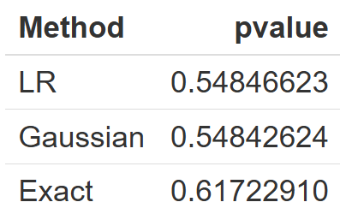
All the P-values are slightly different
You may have noticed that they are slightly different.
This is fine, because we are using approximations!
We should see it approach the Exact for more $n$
Usually, the choice of exact or approximate p-value will not affect the conclusion. However, we must be aware of the limitations of approximate methods and decide the method we end up using BEFORE gathering data!
https://rshiny.math.uwaterloo.ca/sas/stat231/comparingpvalues/

Slide 80
good luck

